Slide 1
Hawke’s Bay Trends
THE STATE OF OUR ENVIRONMENT
September 2022

Slide 2
September 2022
September’s theme is “well above”. Feel free to interpret that as dismal. Rainfall was well above normal and roughly double the month’s long-term average across the region. The Heretaunga Plains nudged towards three times the average. It’s an area that has copped 20 days a month of showers or rain for the past three months. A better balance with dry days and more sun would make a nice change. Cloudy skies and warm sea temperatures helped to push overnight temperatures one degree above the September average. Daytime temperatures resided on struggle street due to sunshine being there too but still managed to be about average for the month. September’s river flows were well above average and soil moisture levels the same. In some places soil moisture has been going rogue by wandering into the top 10% of readings for the time of year, causing headaches for those wanting to plant crops I understand. Groundwater levels remained impressive and so cast sunshine on the month in lieu of it coming from the sky.
Kathleen Kozyniak
Team Leader Marine Air and Land Science

Slide 3
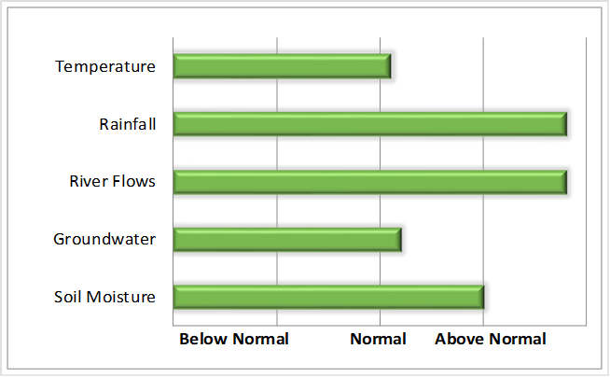
SUMMARY September 2022
Very wet and warm nights.
October to December Forecast
Temperature Above average
Rain Near or above normal
River flows Near or above normal
Soil moisture Near or above normal
source : NIWA
For more information
www.hbrc.govt.nz
P: 06 835 9200

Slide 4
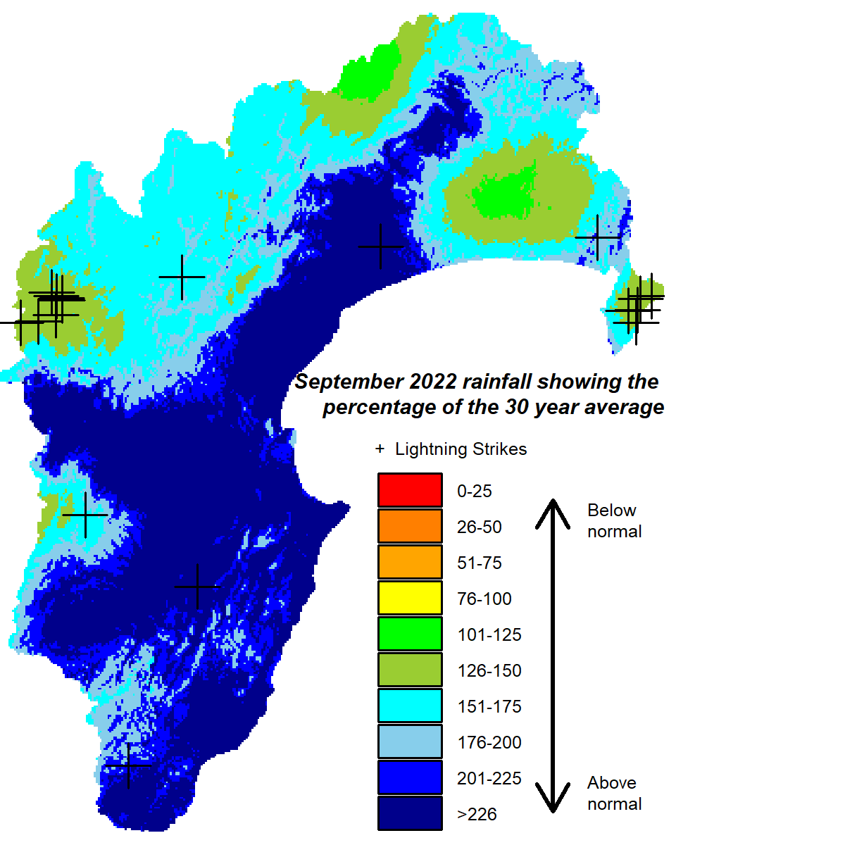
RAINFALL
Well above normal, especially the Heretaunga Plains. 18 cloud to ground lightning strikes.
Lightning counts come from the Blitzortung.org lightning network to which HBRC contributes.
Percentage of normal September rainfall
(30 year average)
For areas in the region:
Waikaremoana 185%
Northern HB 185%
Tangoio 220%
Kaweka 199%
Ruahine 182%
Heretaunga Plains 291%
Ruataniwha Plains 233%
Southern HB 258%
Hawke’s Bay Region 219%

Slide 5
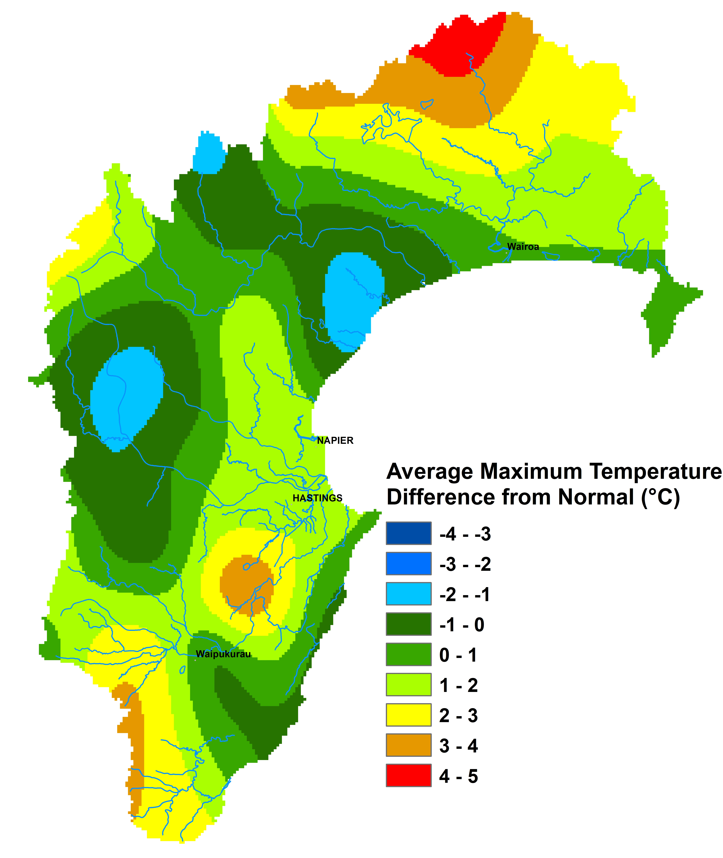
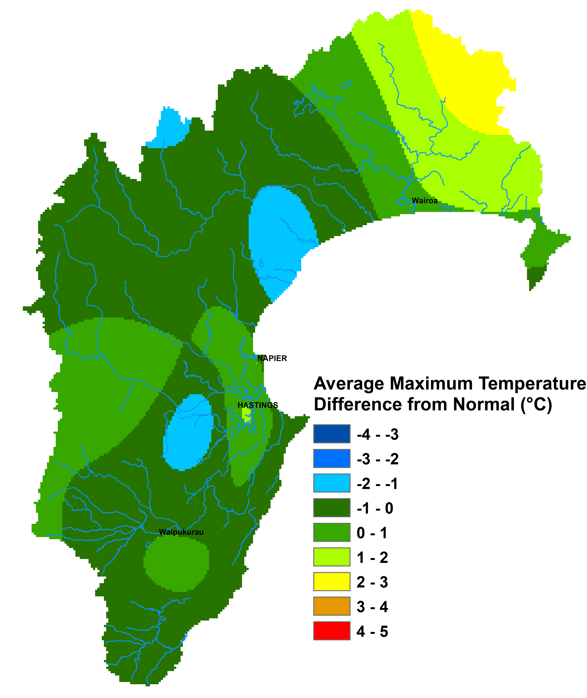
TEMPERATURES
Average during the day, warmer than usual overnight.
Mean Difference from Normal
Maximum Temperature: -0.1°C
Minimum Temperature: 1.0°C
Mean Daily Maximum: 15 °C
Mean Daily Minimum: 7°C
Highest Daily: 23.1 °C
Location: Hastings AWS (Metservice)
Lowest Daily: -3.9 °C
Location: Taharua Climate

Slide 6
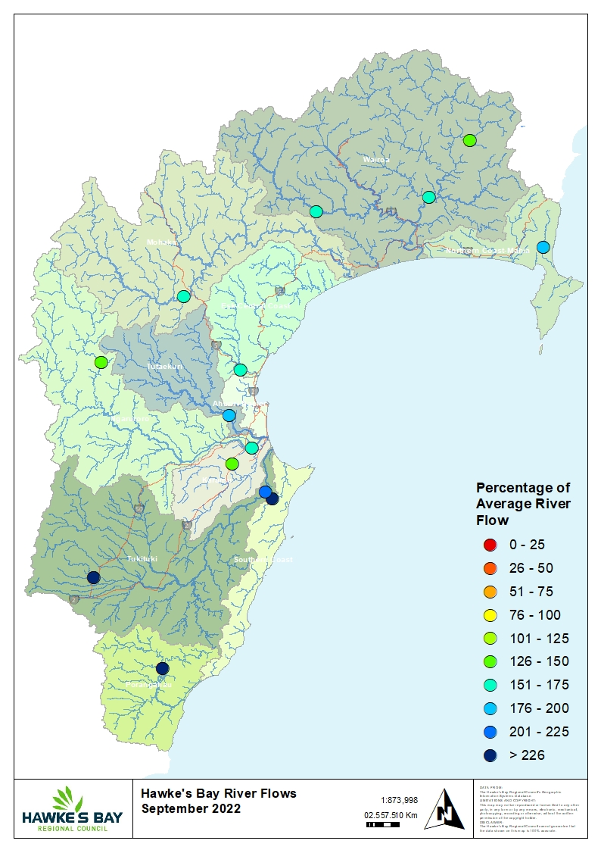
RIVER FLOW
Percentage of average September flows
for areas in the region:
Northern Coast – Mahia 196%
Northern HB – Hangaroa River 149% Northern HB – Wairoa River 161%
Northern HB – Waiau River 152% Mohaka 154%
Esk-Central Coast 155%
Tūtaekuri 181%
Karamu 131%
Ngaruroro – Kuripapango 137%
Ngaruroro – Chesterhope 164%
Southern Coast 227%
Tukituki – Tukipo River 283%
Tukituki – Tukituki River 210%
Porangahau 484%
Hawke’s Bay Region 199%

Slide 7
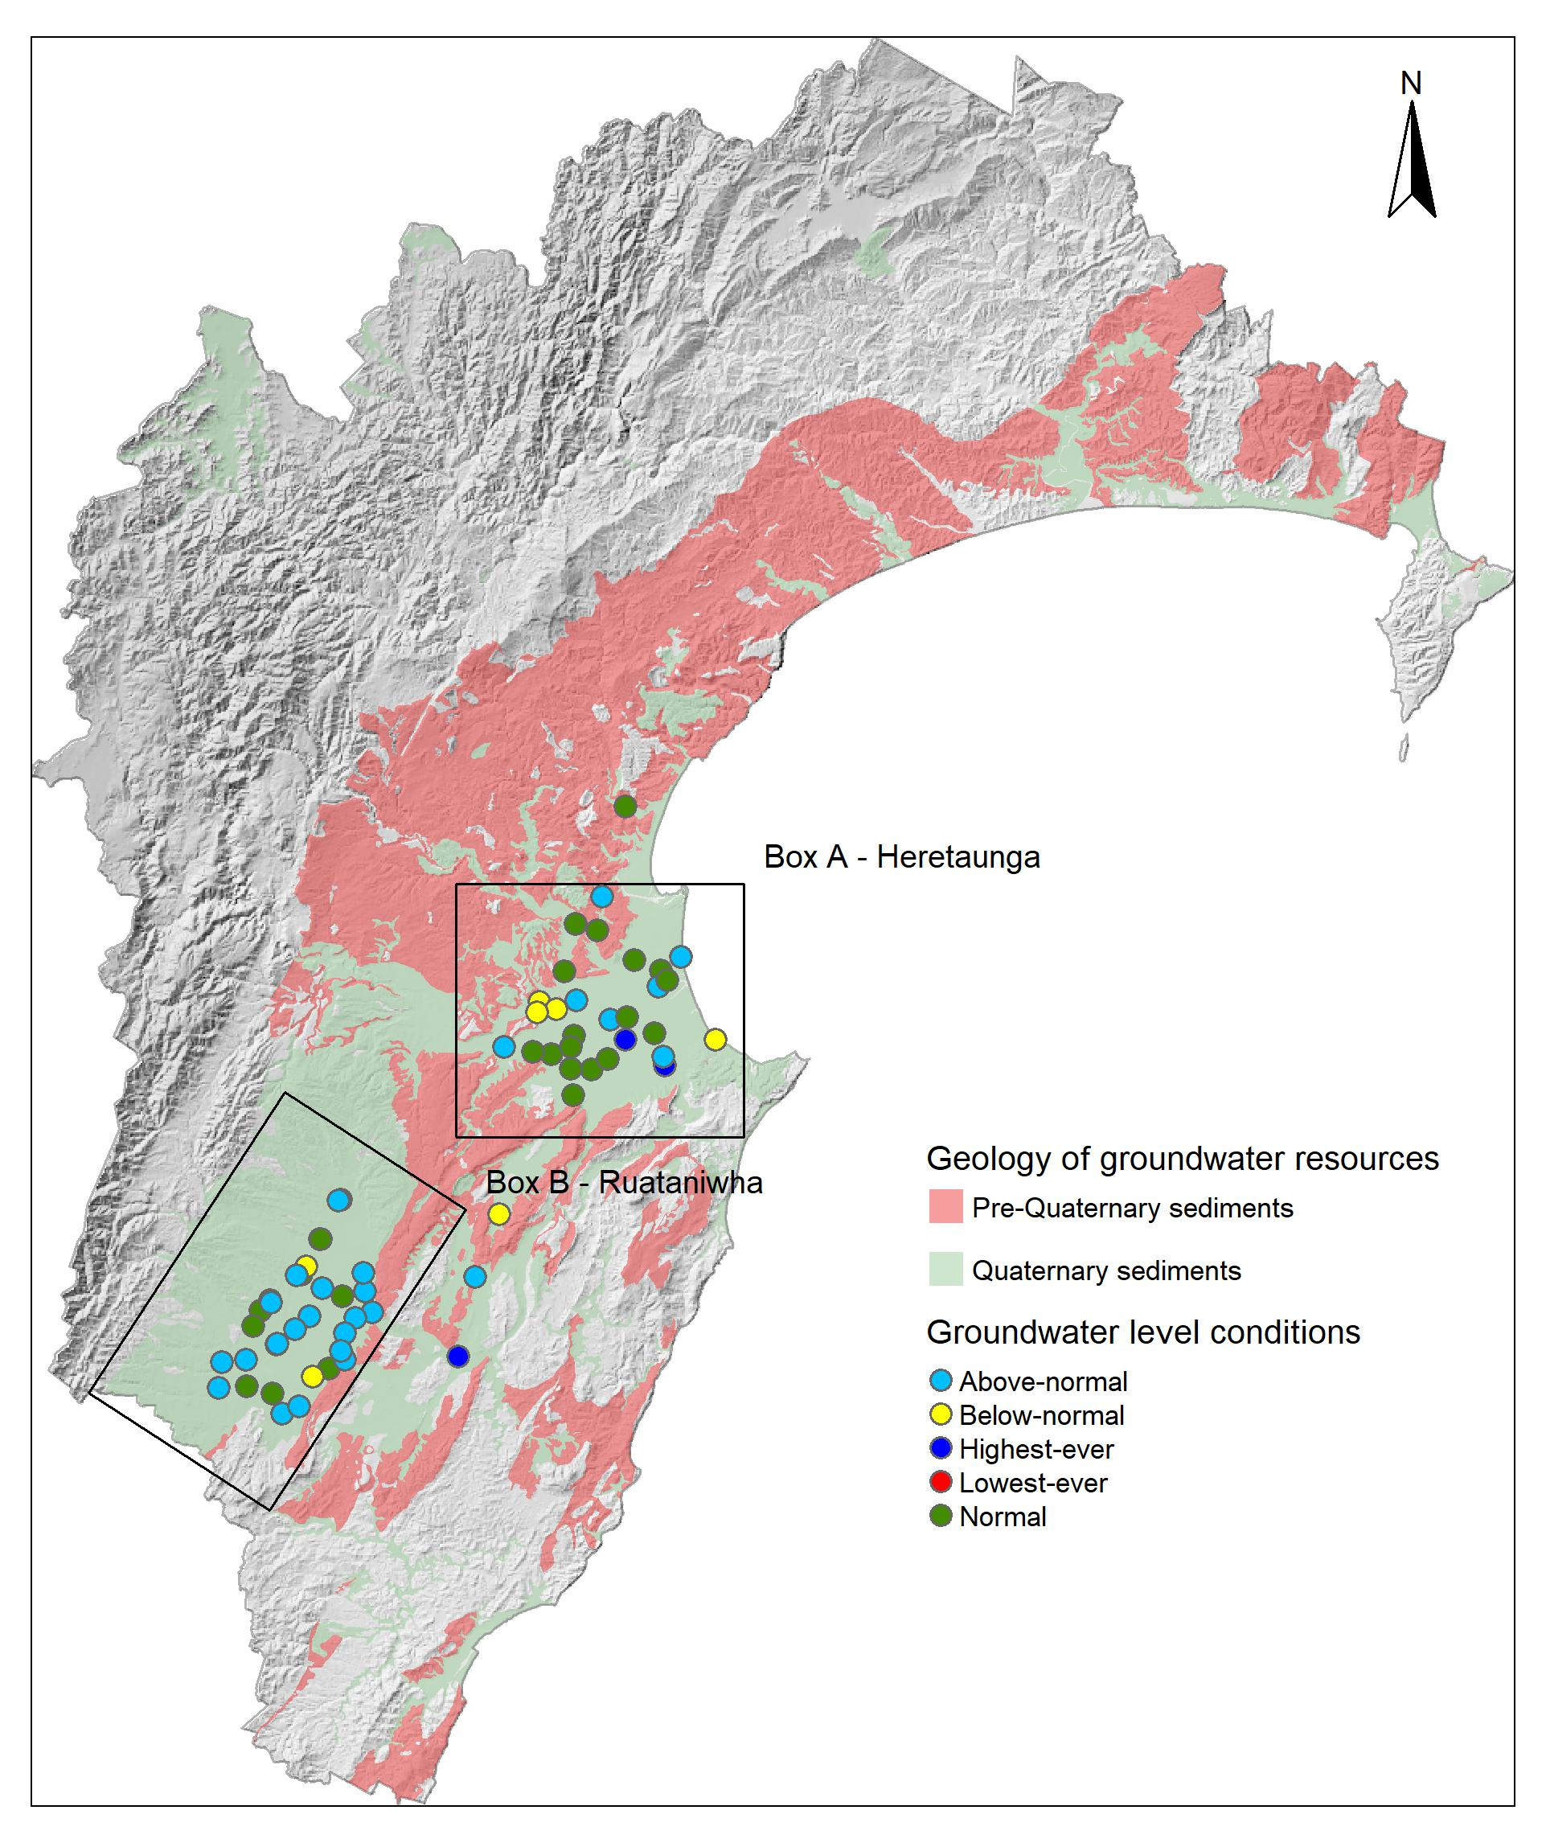
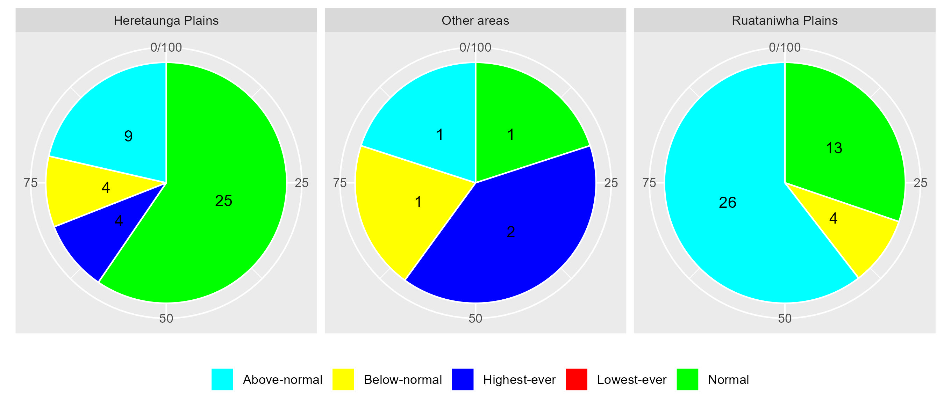
GROUNDWATER & SOIL MOISTURE
Soil Moisture: Above normal.
Current state of Groundwater levels:
This report compares groundwater levels in September with historic readings to evaluate current conditions. To assess these conditions, we have grouped groundwater levels at each well relative to their monthly percentiles.
Groundwater levels measuring between their monthly minimum and 25th percentile are considered below-normal, groundwater levels measuring between the 25th and 75th percentiles are classed as normal, and groundwater levels measuring between the 75th-maximum are considered above-normal. Wells with less than 5 years of record are excluded from the analysis.

Slide 8
LONGER FORECAST
Our triple dip La Niña and the negative Indian Ocean Dipole are in charge of our weather. Sea level pressure is expected to be higher than normal over central and southern New Zealand and lower to the north of the country. That means easterly flows will still feature prominently and make cloudy skies a bit hard to shake. The onshore winds and clouds may subdue our daytime temperatures again but nights will likely be warmer than usual. The rain…well. Normal or above normal. The latter more likely for northern parts of the region, while further south the forecast higher than normal pressures might help us get closer to normal. That’s doubtful for October however, given that two thirds of the month’s average rainfall fell in the first week.
Kathleen Kozyniak
Team Leader Marine Air and Land Science

